Slide 1
Tie Decay

Slide 2
Why is it so important to look at Tie Decay?
Three Processes
  Tie Formation
  Tie Evolution (Development, Maintenance)
  Tie Decay
Cross-Sectional
  Tie Prediction
  Assumed indicator of tie formation
  Can not look at tie decay
Pipes and Flows Metaphor
  Network (edges) very stable (persistent)
  People change through diffusion within networks (social influence)
  Time scales: Assumes networks change at a slower pace than human behavior
Empirical Reality
  Edges come and go
  Tie decay rates are high

Slide 3
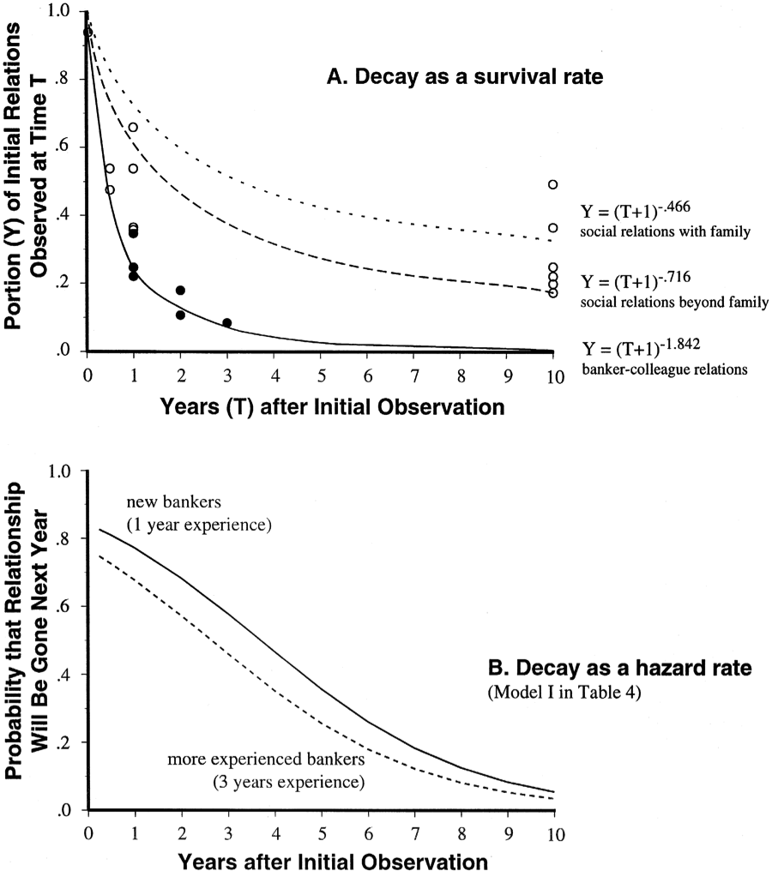
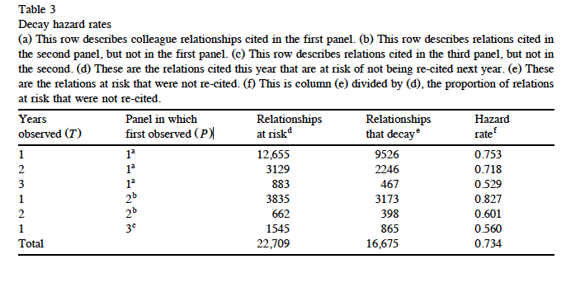
Burt: Tie Decay
formation vs. persistence
liability of newness:
  longer in a state less likely to leave the state
Notes:
compatibility, learning

Slide 4
Burt: Tie Decay - Predictors
Node Age
Tie Age
Strength (subjective measure)
Homophily
  minimal rank homophily
  Gender: M-M lower
  Age
Embeddedness (number of third parties connecting A & B)
  lowers decay, increases persistence
  explains homophily effects
  disruptive embedding (cascading tie decay)

Slide 5
Principles of tie decay
1
.5
Liability of newness
The fundamental principle of tie decay is the liability of newness
  The more recently “born” the tie is the more likely it is that it will not be observed in the future
Probability of that the tie will be gone at next time step
1 2 3 4 5 6 7 8
Time

Slide 6
Principles of tie decay
1
.5
Simmelian Dyads
The liability of newness is conditioned by a variety of factors
  Most important: Simmelian dyad status
Probability of that the tie will be gone at next time step
“Standalone” Dyads
1 2 3 4 5 6 7 8
Time

Slide 7
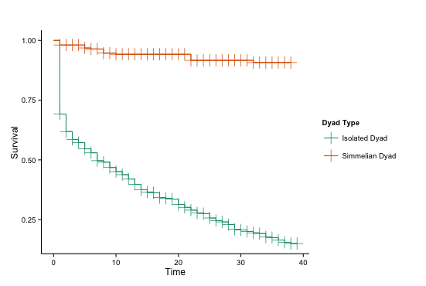
Principles of tie decay
The liability of newness is conditioned by a variety of factors
  Most important: Simmelian dyad status

Slide 8
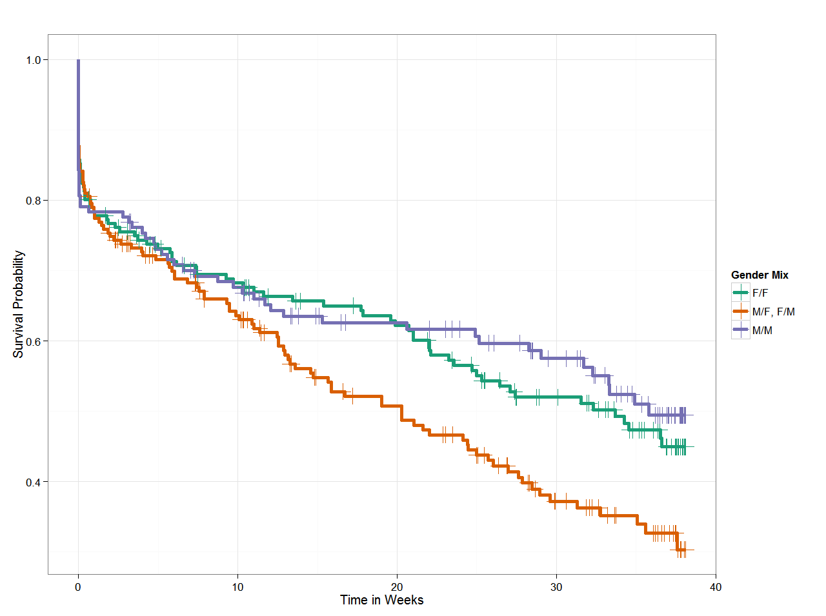
Principles of tie decay
The liability of newness is conditioned by a variety of factors
  Most important: Simmelian dyad status
  Also:
    Node characteristics
    Tie-strength
    Homophily
    Social Foci
  Transitions out Simmelian status bring back the liability of newness

Slide 9
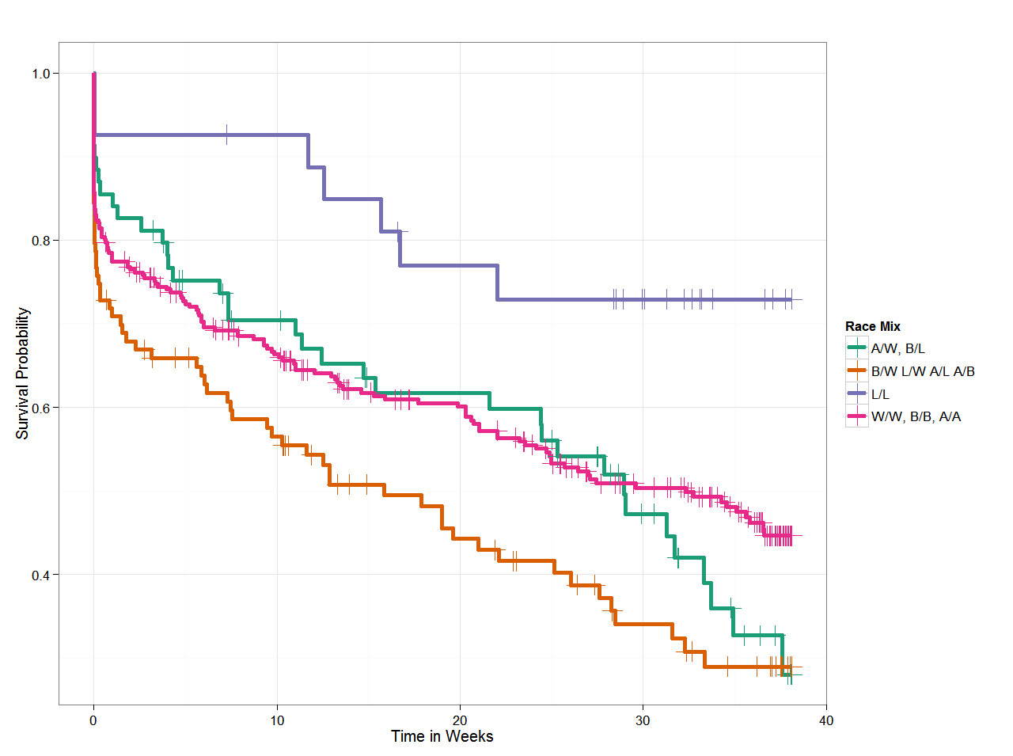
Principles of tie decay
The liability of newness is conditioned by a variety of factors
  Most important: Simmelian dyad status
  Also:
    Node characteristics
    Tie-strength
    Homophily
    Social Foci
  Transitions out Simmelian status bring back the liability of newness

Slide 10
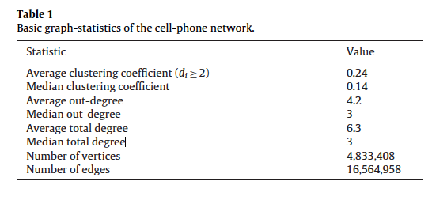
Tie Decay Model
Cell phone data

Slide 11
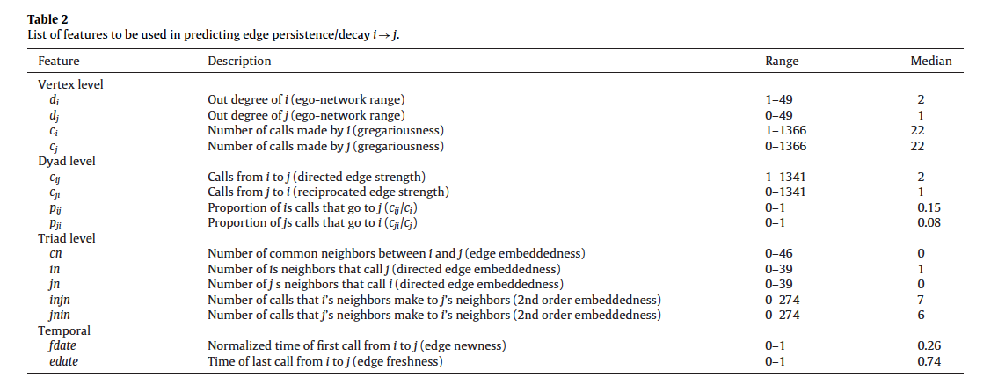
Possible Predictors of Tie Decay

Slide 12
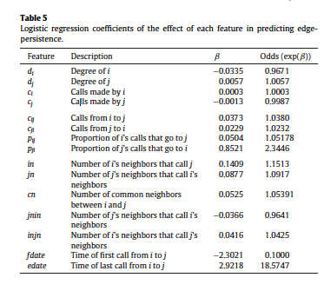
Regression Results

Slide 13
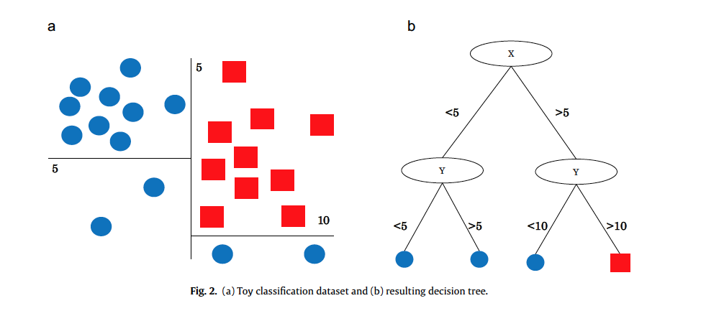
Machine Learning Logic

Slide 14
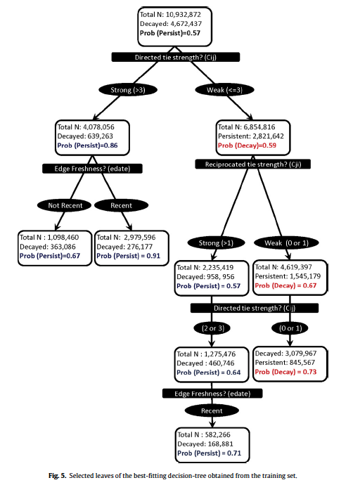
Decision-Tree Results
Path 1
  directed tie strength > 3
  recent activation
Path 2
  somewhat weak tie
  reciprocated
  recent activation
Strong ties persist
Weaker ties can persist if they become reciprocate
  They then can also strengthen with time
Net of this, embeddedness not important.

Slide 15
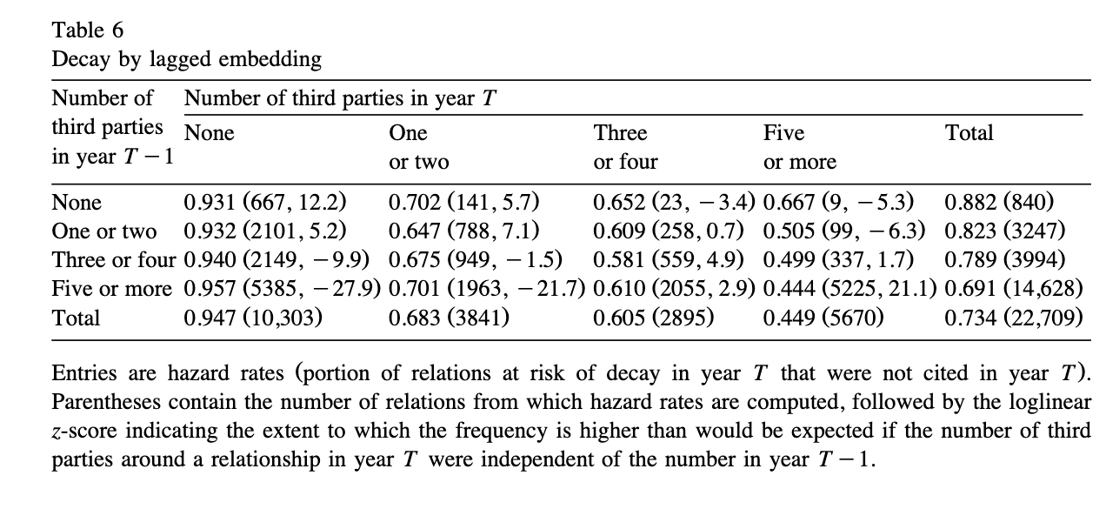
Embeddedness

Slide 16
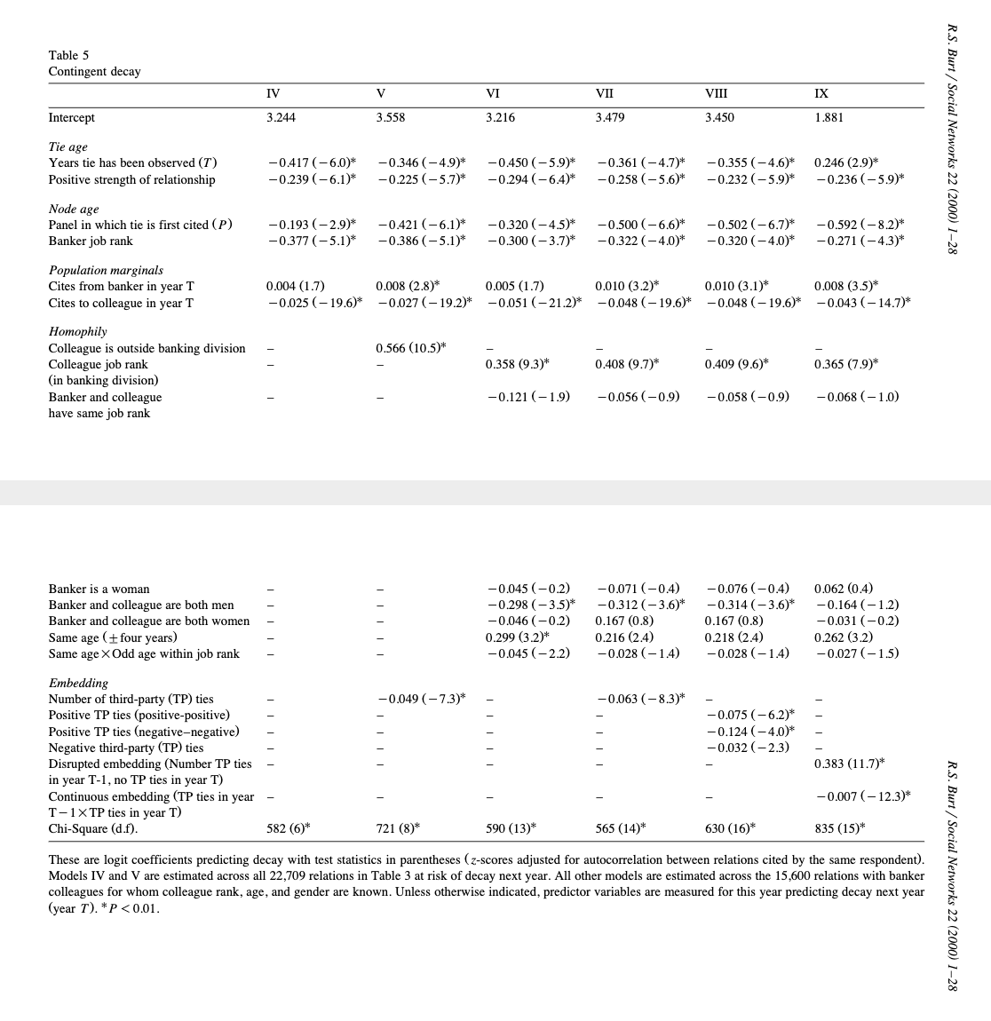
Embeddedness

